Slide 1
Data Platforms - Under the hood
Manuele Pasini
manuele.pasini@unibo.it
09/12/2025
Intro
Who am I ?
Manuele Pasini, Ph.D. Candidate in Computer Science and Engineering
University of Bologna, Business Intelligence Group
:::{.fragment}
Area of Interest:
(Almost) the whole data* world.
Data engineering;
Data integration;
Precision Agriculture:
Irrigation management
Data Platform for italian agriculture domain @Agritech
A Cloud Data Platform
Is a centralized infrastructre composed of independent and well-integrated services meeting the end-to-end needs of data pipelines:
Centralized: a data platform is conceptually a single and unified component;
Independent: changes in a a service do not affect others;
Well-integrated: services have interfaces enabling a frictionless composition;
End-to-end: services cover the entire data life cycle.
A case study - The Agritech PNRR Project
Goal: Build a data platform to Foster collaboration and integration between different agriculture research projects.

Slide 2
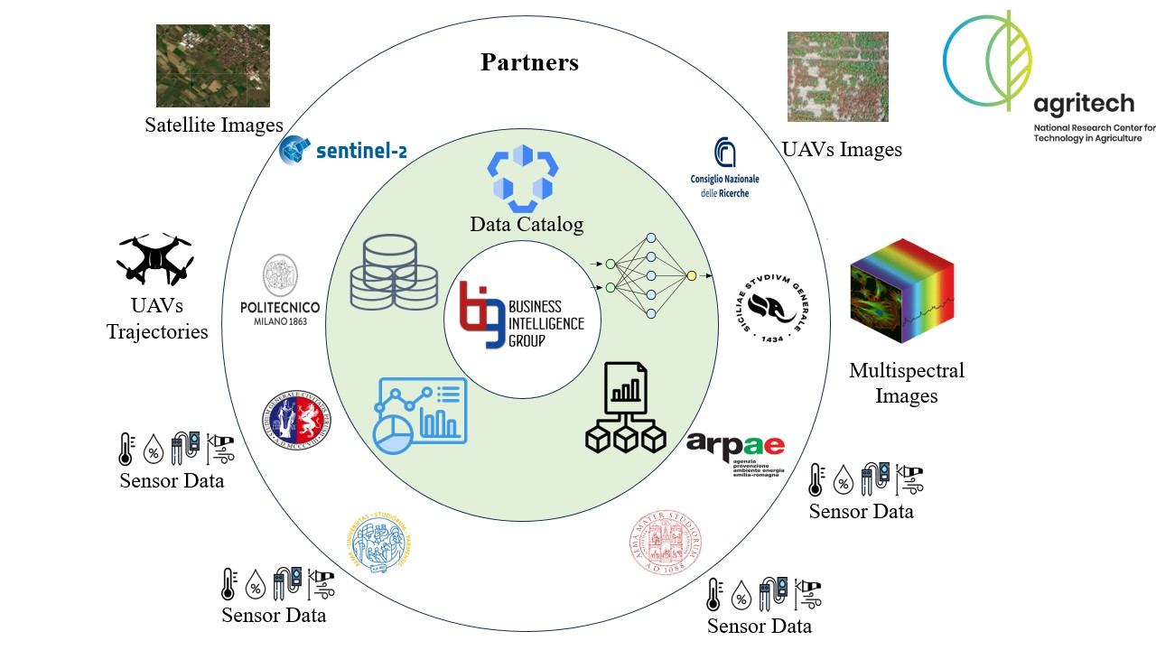
In short:
6 research partners;
highly heterogeneous data;
different goals;
Main challenges:
Governance issues;
Sharing issues.
Agritech project

Slide 3
Let’s talk deploy!
On a hardware level

Slide 4
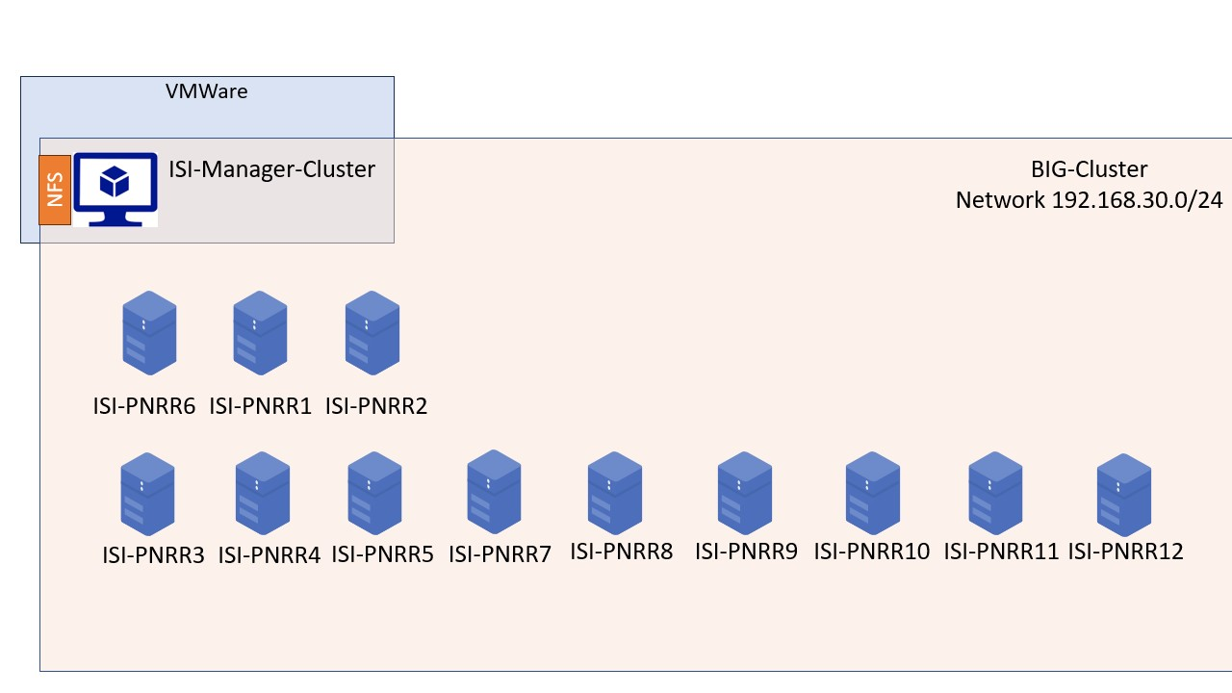
12 Nodes (and counting…)
CPU 20 core w5-2445 @4.6 GHZ
256 GB RAM
12 TB HDD
2 GPUs NVIDIA RTX 6000 Ada Generation
1 Network File System (3 TB)
Hardware architecture

Slide 5
On a hardware level

Slide 6
We don’t really want to work on bare metal…
Need for fault tolerance mechanisms;
Might face dependencies issues;
… We want to virtualize
remember the independence constraint.
Docker Swarm !
Hardware + Docker architecture
Hardware + Docker architecture

Slide 7
A Docker overview
Docker is a platform for developing, shipping and running isolated application using container based virtualization technology.

Slide 8

w.r.t. virtual machines (e.g., VMWare):
more lightweight;
no guest OS;
reduced resource consumption;
more containers per host;
greater portability
Container vs. Virtual Machines

Slide 9
Docker Swarm
Swarm mode is an advanced feature for managing a cluster of Docker daemons.

Slide 10
Characteristics:
Integrated Orchestration;
Decentralized Management;
multi-host networking;
load balancing;
scaling features;
service discovery;
rolling updates
Docker swarm architecture

Slide 11
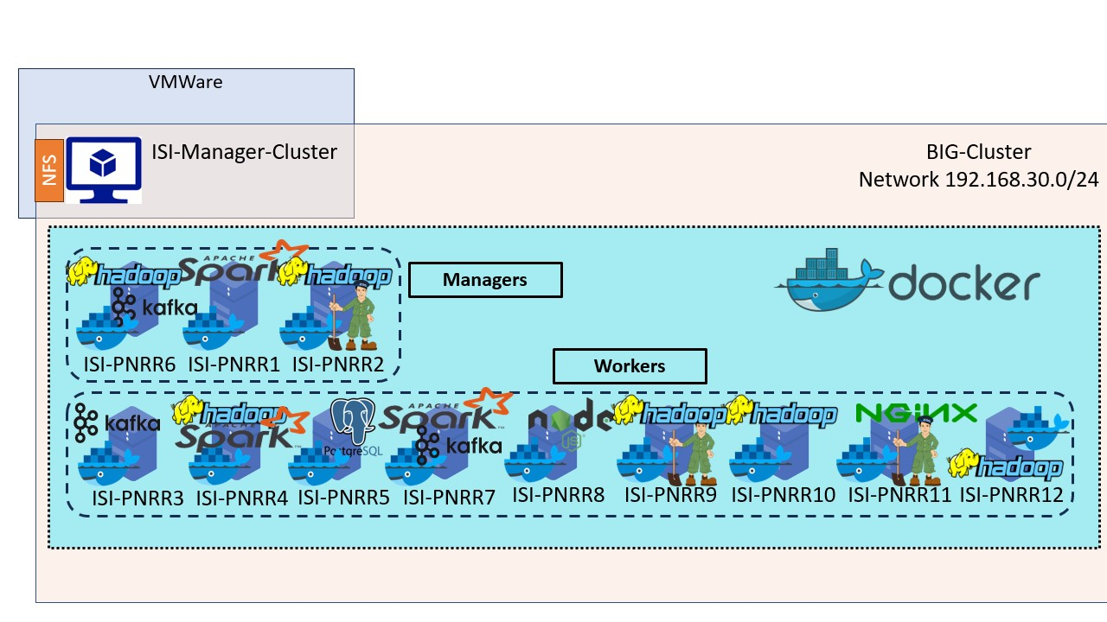
Building a Data Platform
Platform services as Docker services.
This is the what, but…
… Too many things in one-flat schema, we need to add another dimension.
Docker swarm architecture

Slide 12
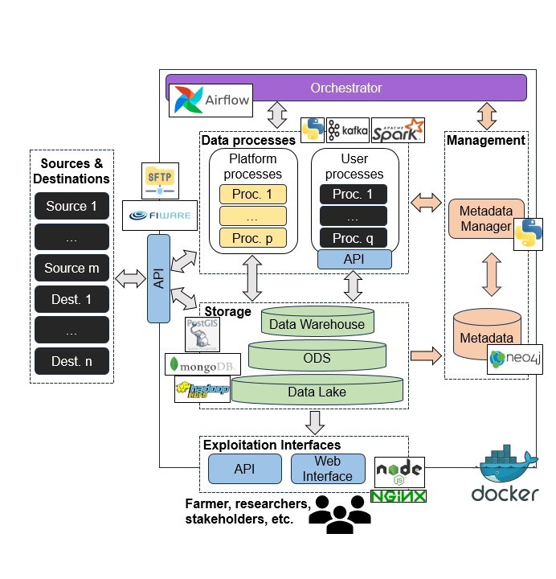
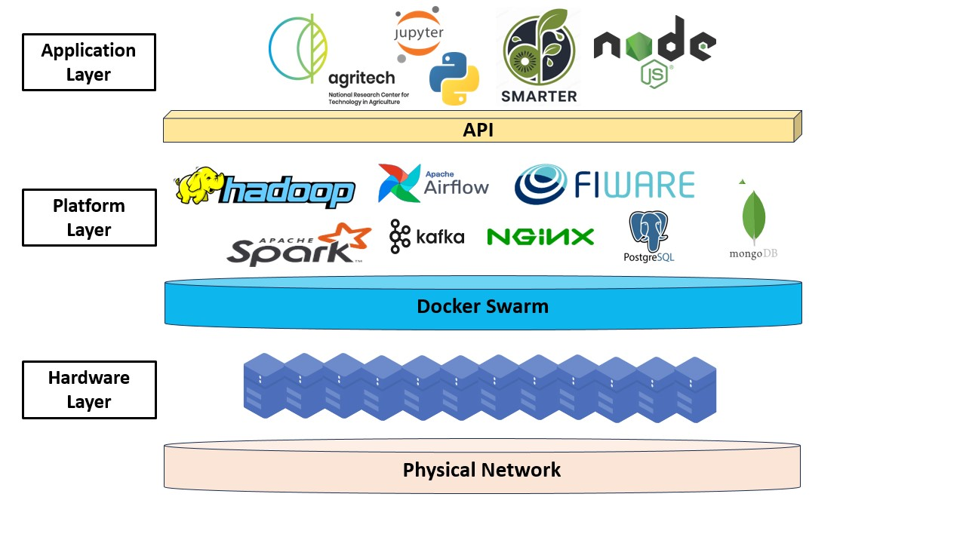
A perspective change
Now we know the where…
What about the how ?
A functional view
test2
Vertical view on BIG Data platform
Functional view

Slide 13
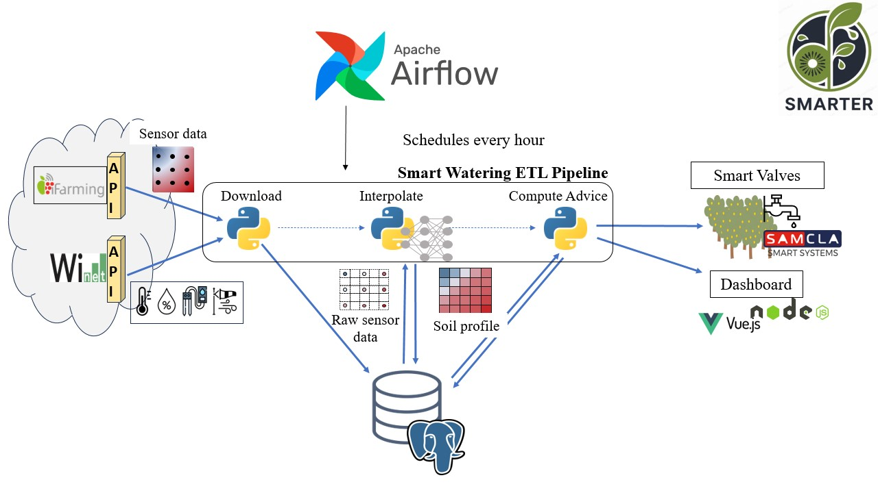
test3

Slide 14
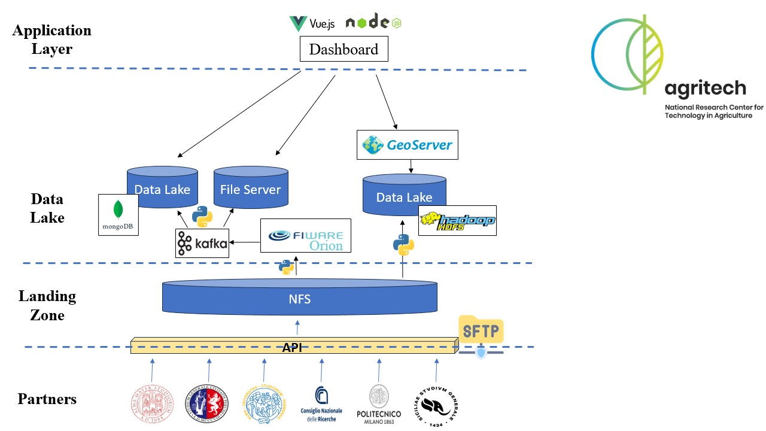
test4

Slide 15
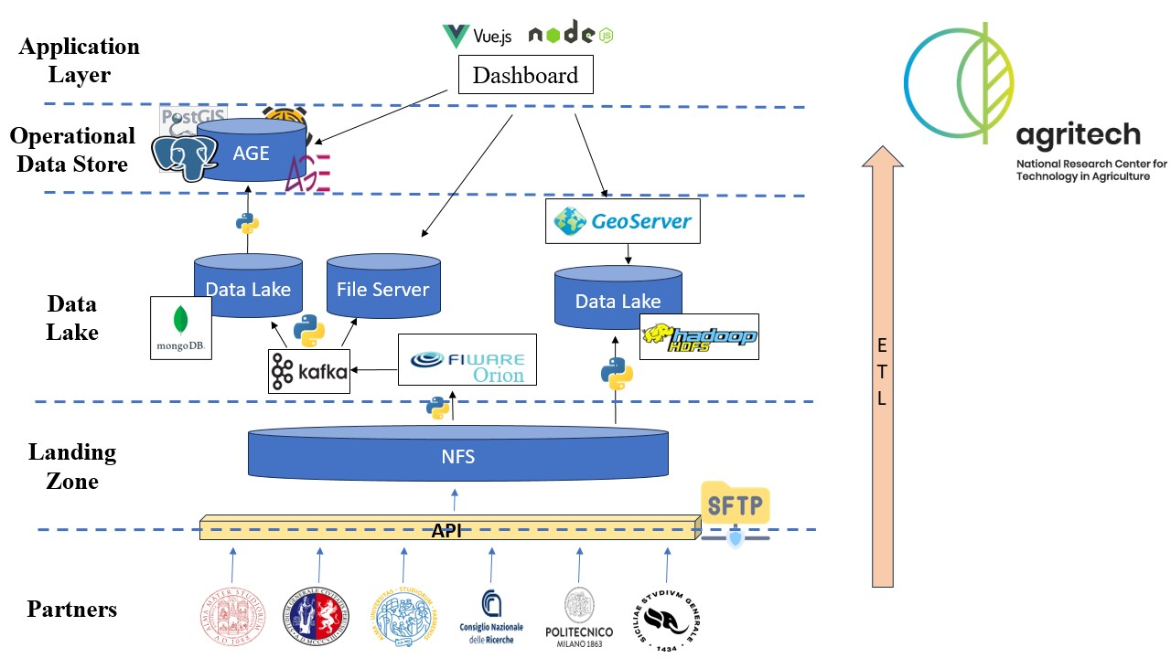
test5

Slide 16
test6

Slide 17
test7

